Slide 1


Social Buzz Analysis

Slide 2


Today's agenda
Project recap
Business Problem
The Analytics team
Process
Insights
Summary

Slide 3

Social Buzz is fast growing technology unicorn that need to adapt quickly to its global scale.
Accenture has started working on the following activities during a three-month POC:
An examination of Social Buzz’s use of big data
Strategies for a prosperous initial public offering(IPO)
An examination to determine the top 5 content category on Social Buzz
Project Recap

Slide 4

Problem
Over 100000 posts per day.
36,500,000 pieces of content per year.
But how to capitalize on it when there is so much?
Analysis to find social buzz’s top 5 most popular categories of content.

Slide 5



Linda
Sr. Data Analyst
The Analytics team
Shirely
Data Analyst
Prabha
Jr. Data Analyst

Slide 6
Process
1
Understanding Data
2
Data Cleaning
3
Data Modelling
4
Data Analysis
5
Uncover Insights

Slide 7
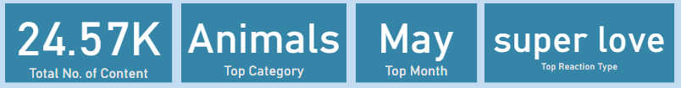

Insights

Slide 8
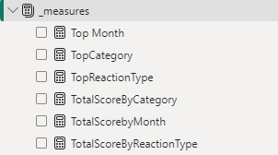
Measures Used
TotalScoreByReactionType =
SUMX(
VALUES('Reactions'[Reaction Type]),
CALCULATE(SUM('Reactions'[Score]))
)
TopReactionType =
VAR TopReactionTable =
SUMMARIZE(
'Reactions',
'Reactions'[Reaction Type],
"TotalScore", [TotalScoreByReactionType]
)
VAR TopReaction =
TOPN(
1,
TopReactionTable,
[TotalScore],
DESC
)
RETURN
MAXX(TopReaction, 'Reactions'[Reaction Type])

Slide 9
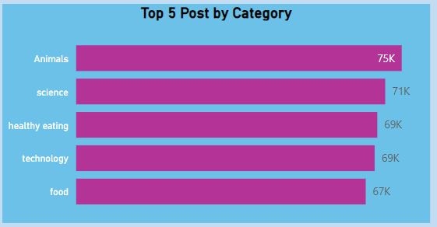
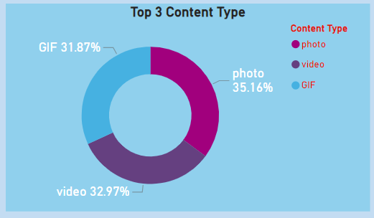
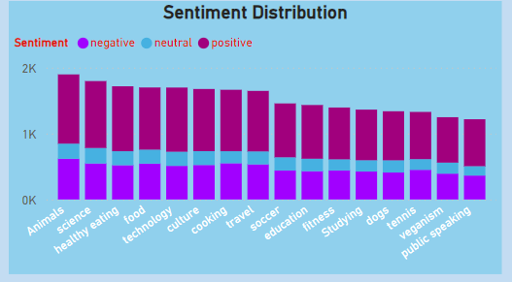
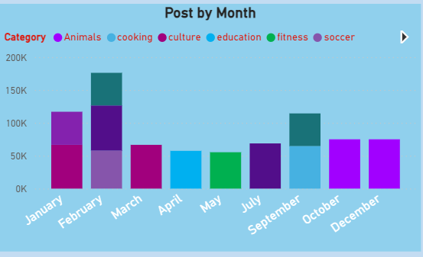

Slide 10
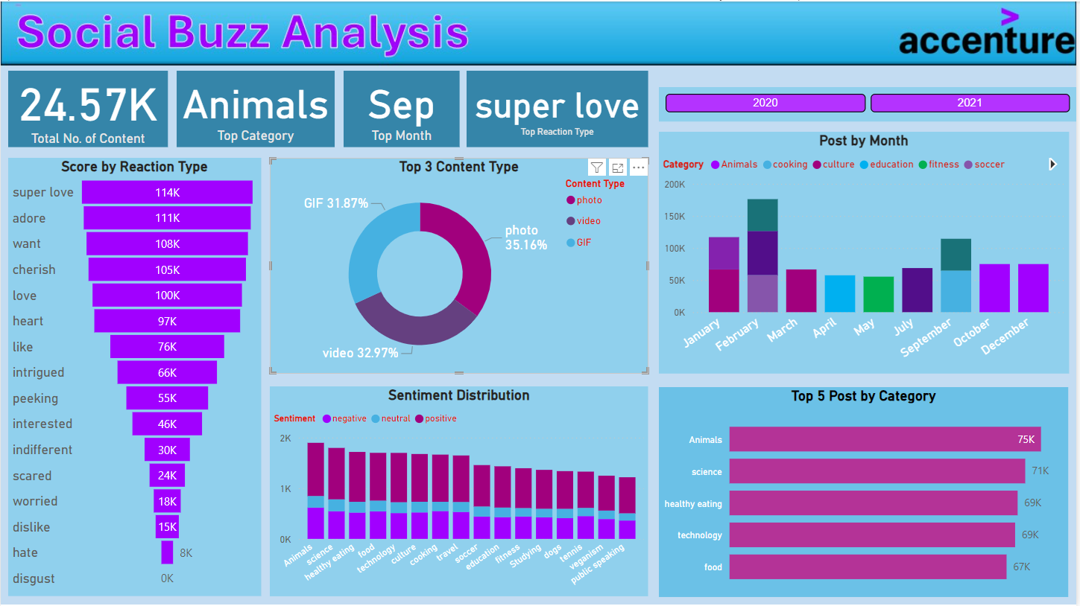

Slide 11

Analysis
“Animals” and “Science” are two most popular categories of content showing that people “real-life” and “actual” content the most.
Insight
Food was common theme with the top 5 categories with the highest “health eating” ratings. This may give the audience an indication of the “social buzz” user base. “Social Buzz” can use insights to create campaigns and work with healthy food brands to increase user engagement
Next Steps
This ad-hoc analysis is insightful, but it’s time to take this analysis into large scale production for real – time understanding of “social buzz” business
Summary

Slide 12
Thank you!
ANY QUESTIONS?

